Slide 1
JavaScript:
Events and Events Handling
Yuriy Bezgachnyuk
August, 2014

Slide 2
Special Thanks
to John Resig

Slide 3

Agenda
Events
  What is event
  Phases of event
  How to handle events
  Event Object
  Keyboard and mouse events
Exception handling

Slide 4
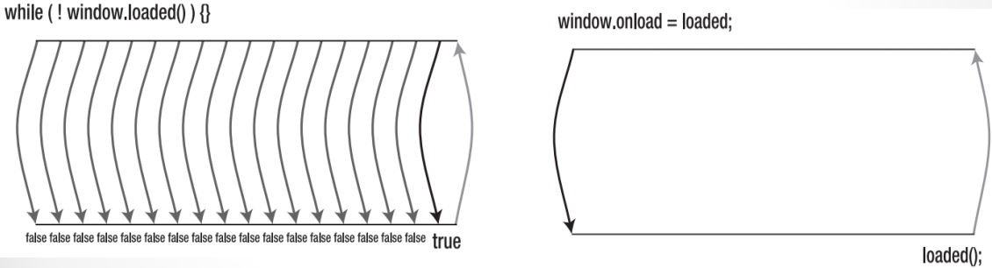
Events
Event – an action that is fired (initiated) within a web page.
JavaScript is Single Thread
JavaScript uses asynchronous callback

Slide 5
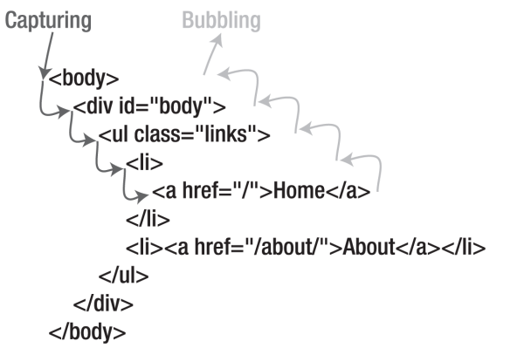
Phases of Event
Phase #1 – Capturing
Phase #2 – Bubbling

Slide 6
Defining Event Handler
Old way
window.onload = function() {};
New way (add event)
window.addEventListener(”load”,func,false)
window.attachEvent(”onload”,func); // IE < 9
We can define event handler only for objects!!!

Slide 7
The Event Object
Contains contextual information about the current event
An object that’s provided, or is available, inside of every event handler function
W3C Standard Browser: e
Internet Explorer: window.event

Slide 8
Cancel Bubbling
Since you know how event capturing/bubbling works, let’s explore how you can take control it.
W3C
  e.stopPropagation()
IE
  window.event.cancelBubble
Live Example (Thanks for J. Resig ☺)

Slide 9
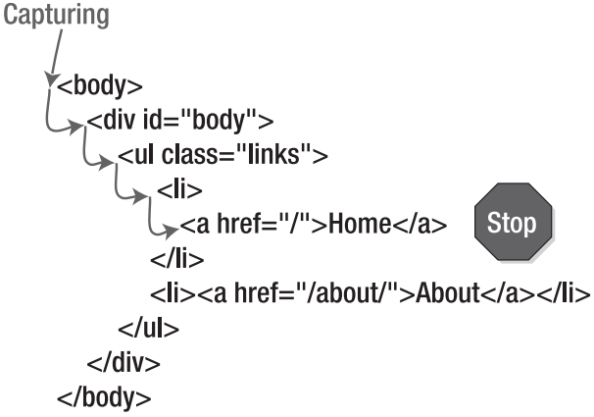
Cancel Bubbling (Scheme)

Slide 10
Cancel Bubbling (Code + Live☺)
function stopBuuble(e) {
if (e && e.stopPropagation) {
e.stopPropagation();
}
else {
window.event.cancelBubble = true;
}
}
var all = document.getElementsByTagName("*");
for (var i = 0;i < all.length;i++) {
all[i].onmouseover = function(e) {
this.style.border = "1px solid red";
stopBuuble(e);
};
all[i].onmouseout = function(e) {
this.style.border = "0px";
stopBuuble(e);
};
}

Slide 11
Overriding Browser Default Event
For most events that take place, the browser has some default action that will always occur.
  For example, clicking an <a> element will take you to its associated web page; this is a default action in the browser. This action will always occur after both the capturing and the bubbling event phases

Slide 12
Overriding {code: true, live:true}
function stopDefault(e) {
if (e && e.preventDefault) {
e.preventDefault();
}
else {
window.event.returnValue = false;
}
}
var iframe = document.getElementById("iframe");
var a = document.getElementsByTagName("a");
for (var i = 0;i < a.length;i++) {
a[i].onclick = function(e) {
iframe.src = this.href;
return stopDefault(e);
};
}

Slide 13
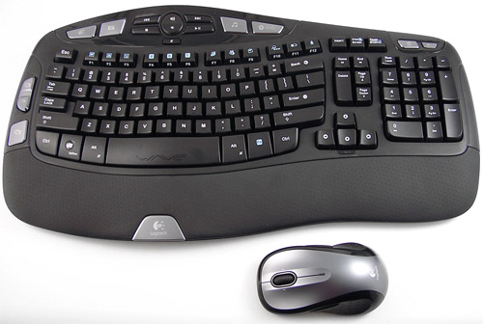
Keyboard and Mouse Events
Mouse Events
  onMouseDown
  onMouseMove
  onMouseOut
  onMouseOver
  onMouseUp
  onClick
  onDblClick
  onDragDrop
Keyboard Events
  onKeyDown
  onKeyPress
  onKeyUp

Slide 14
Practice: Handling Mouse events
Task: <div> container must change
bg-color after some mouse event
  hover => yellow;
  click => red;
  dblclick =>blue;
  out =>white;

Slide 15
Code
<body>
<div id="container">
</div>
<script type="text/javascript">
var div_c = document.getElementById("container");
div_c.addEventListener("mouseover", a, false);
div_c.addEventListener("mouseout", b, false);
div_c.addEventListener("click", c, false);
div_c.addEventListener("dblclick", d, false);
</script>
</body>
...
function a()
{
div_c.style.backgroundColor = "yellow";
}

Slide 16
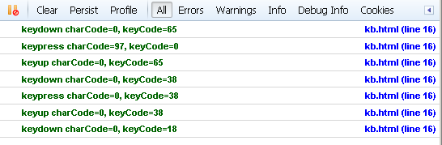
Keyboard Events Handling
Let’s investigate little part of code
<script type="text/javascript">
window.addEventListener("keydown", handleEvent, false);
window.addEventListener("keypress", handleEvent, false);
window.addEventListener("keyup", handleEvent, false);
</script>
<script type="text/javascript">
function handleEvent(e) {
var e = e || window.event;
console.log(e);
}
</script>

Slide 17
And so what we have…?
After investigation previous slide we can see next features of KB events:
  keydown → keypress → keyup (sequence of KB events!!!)
  Some KB events have value (not 0) of property charCode (keypress event only).
  keydown and keyup events generate scan-code only (keyCode property) which always similar and don’t depends on KB layout!!!

Slide 18
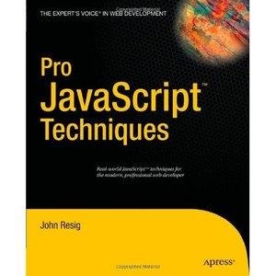
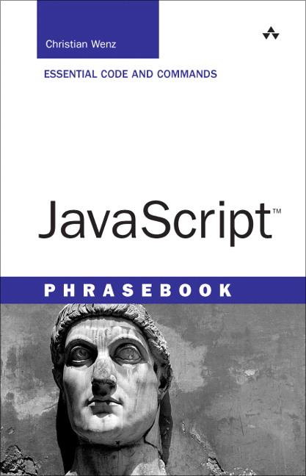
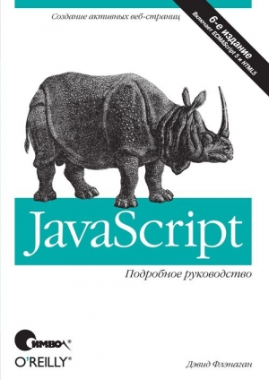
References and sources
John Resig Pro JavaScript Techniques
David Flenagan JavaScript
Christian Wenz JavaScript Phrasebook
https://developer.mozilla.org/

Slide 19

Questions?

